Slide 1

DEPARTMENT OF COMPUTER ENGINEERING
CUBE
Student name: Kunj Patel | Roll no:66 | Division: B
Student name: Prince Pal | Roll no:54 | Division: B
Student name: Saket Nigam | Roll no:50 | Division: B
Student name: Avadh Pandey | Roll no:58 | Division: B
Under the Guidance of: Prof.Ashwini Gaikwad

Slide 2

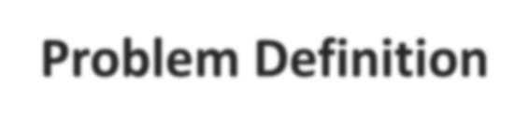

Problem Definition
Communication between individuals or groups have grown from Emails to chat rooms and chat applications, but the number of contacts and groups a person has also increased significantly. A teacher from an educational institute teaches multiple classes and subjects and for better communication with students they create chat groups for each individual class and thus has to manage multiple chat groups and the student after each passing year encounters a different class thus a new group. The notices of exams, events or holidays, pdfs of study material timetables, forms, doubts of students etc. these msgs are quite frequent and at times the important ones are lost in this clutter of different messages and its difficult to find them via scrolling through those useless messages. There are also similar problems with other types of groups as well not just educational groups

Slide 3

Objectives
The objective of CUBE is to create a web-based chat application that helps to declutter these messages by adding a separate space for each genre of messages so its easier to navigate to the messages we require at that time without the need to scroll through those endless messages which we do not require at the moment.
To make the existing system of chat applications more effective by modeling it after a tree with branches and sub-branches which will help the user to easily navigate through different types to messages.
To urge the user to make subgroups according to their need and assign a name befitting the task which it will serve and use it for its messages of the same genre.

Slide 4

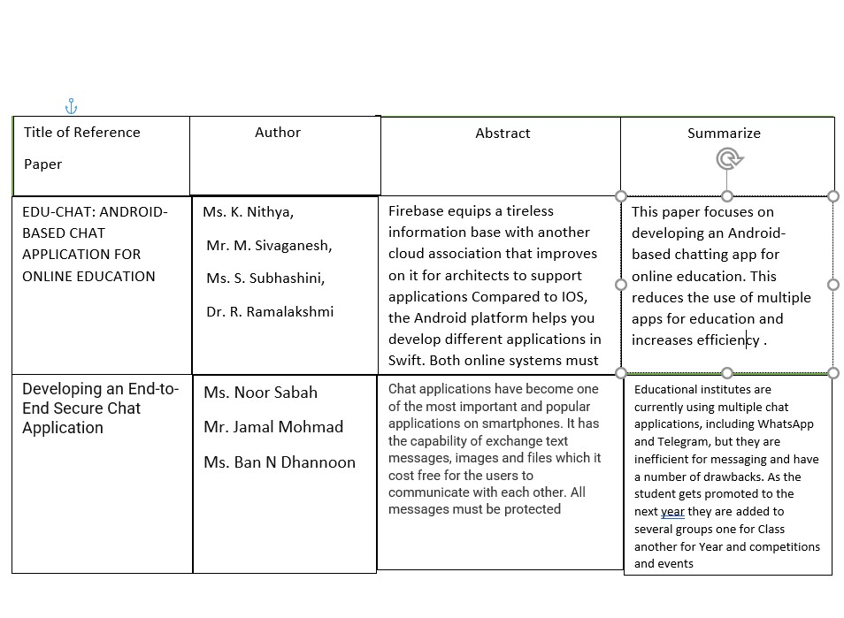
Literature Survey
13/ March- 2022
November 2017

Slide 5

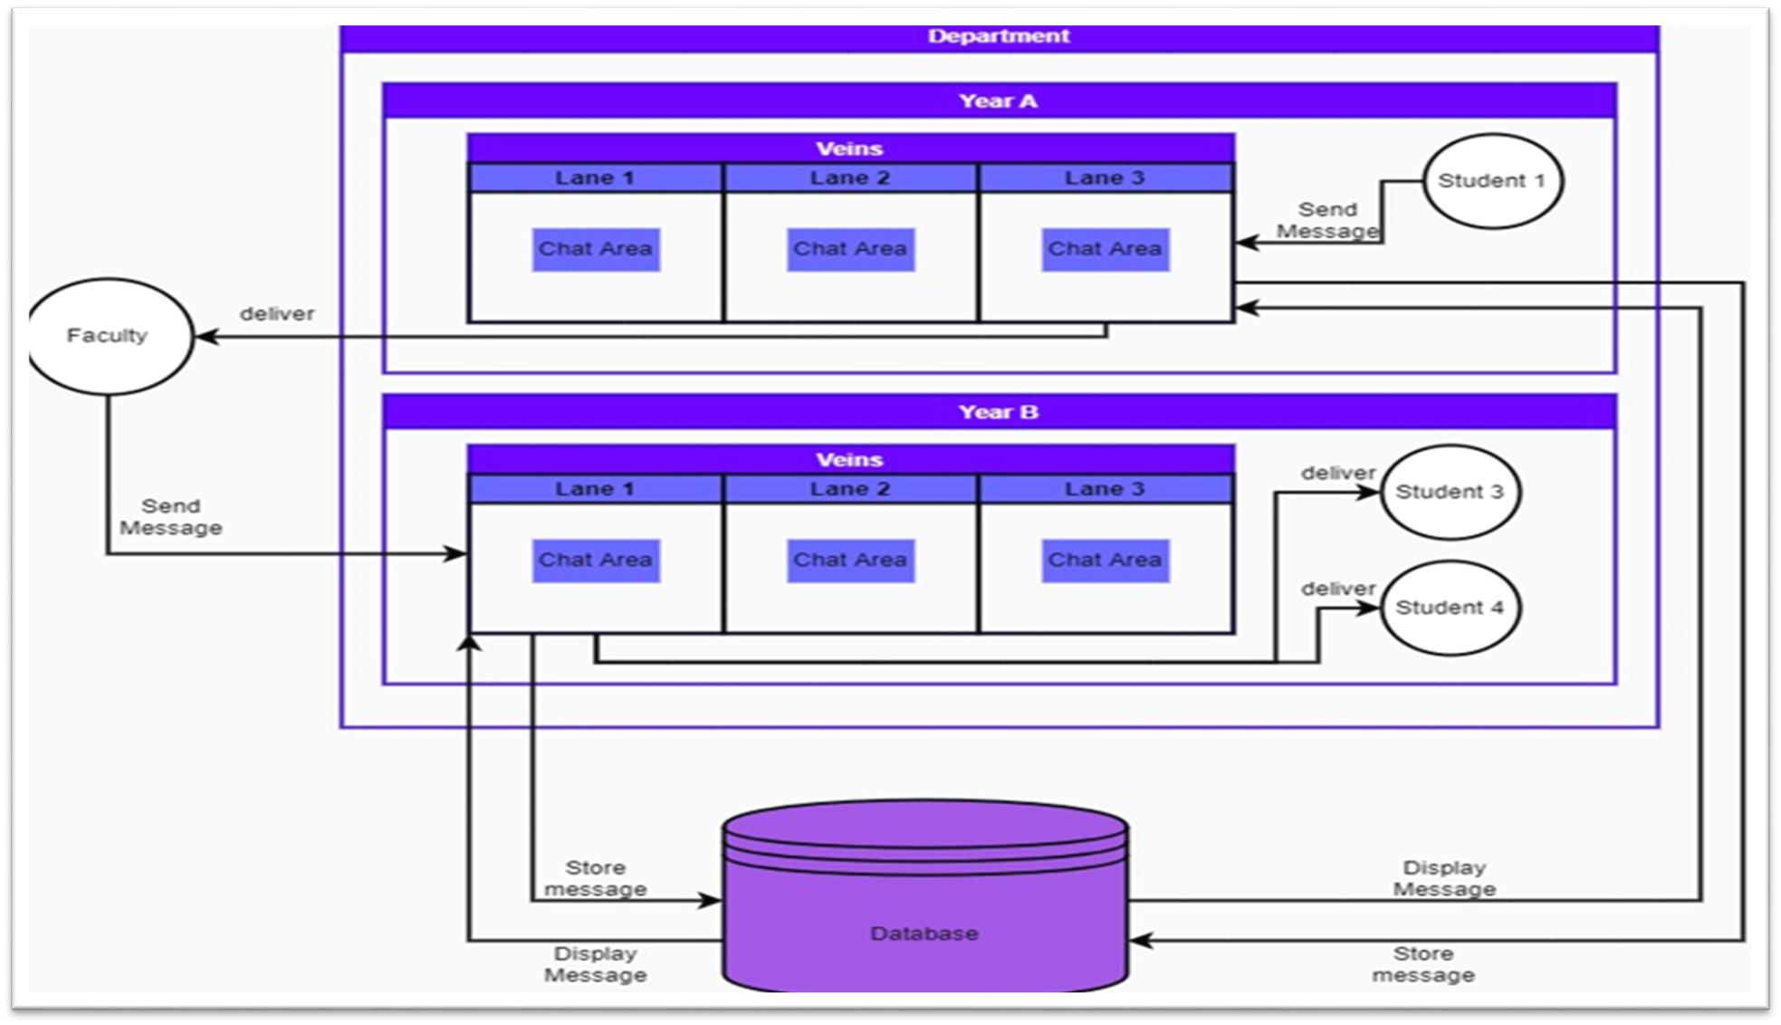
Architectural Diagram

Slide 6


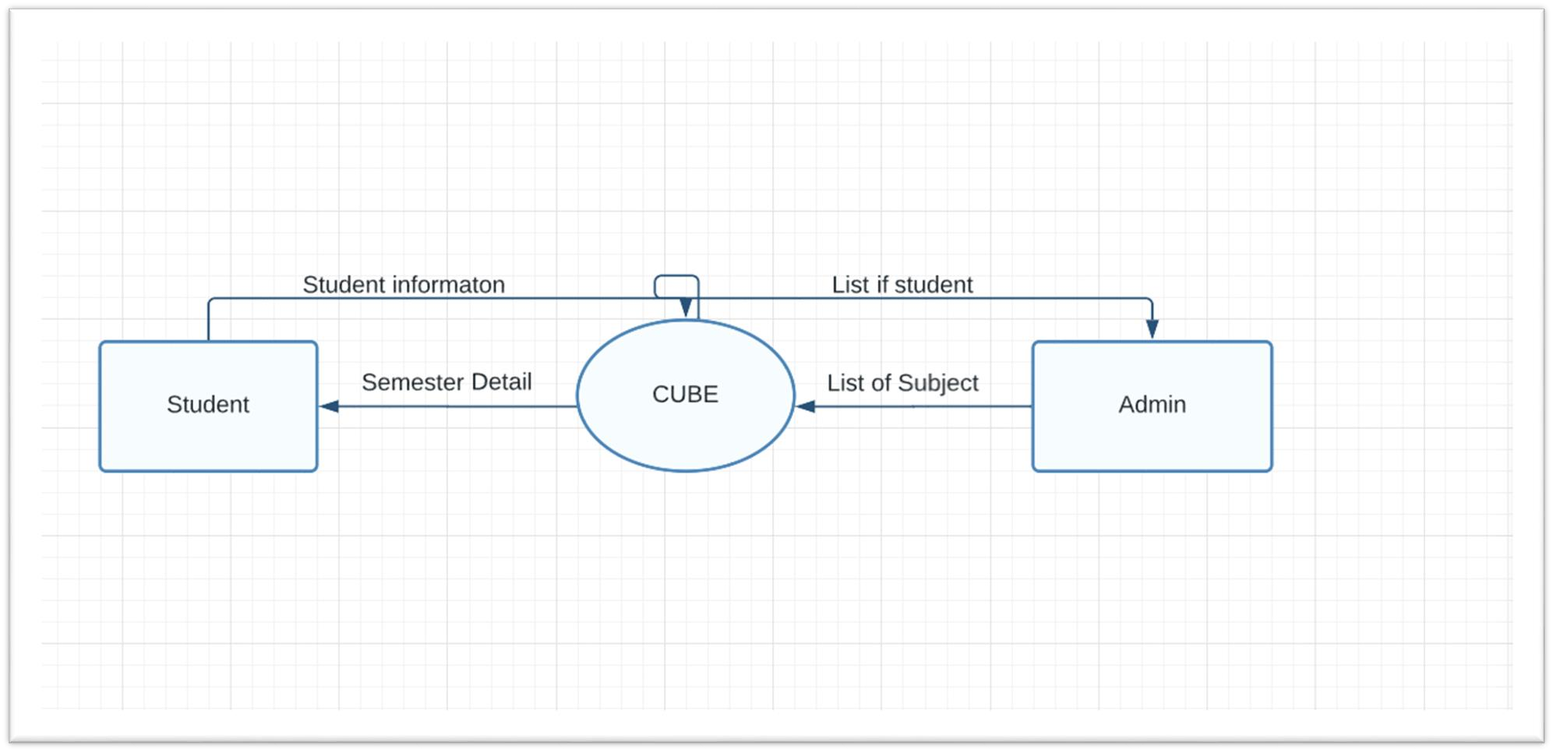
DFD

Slide 7

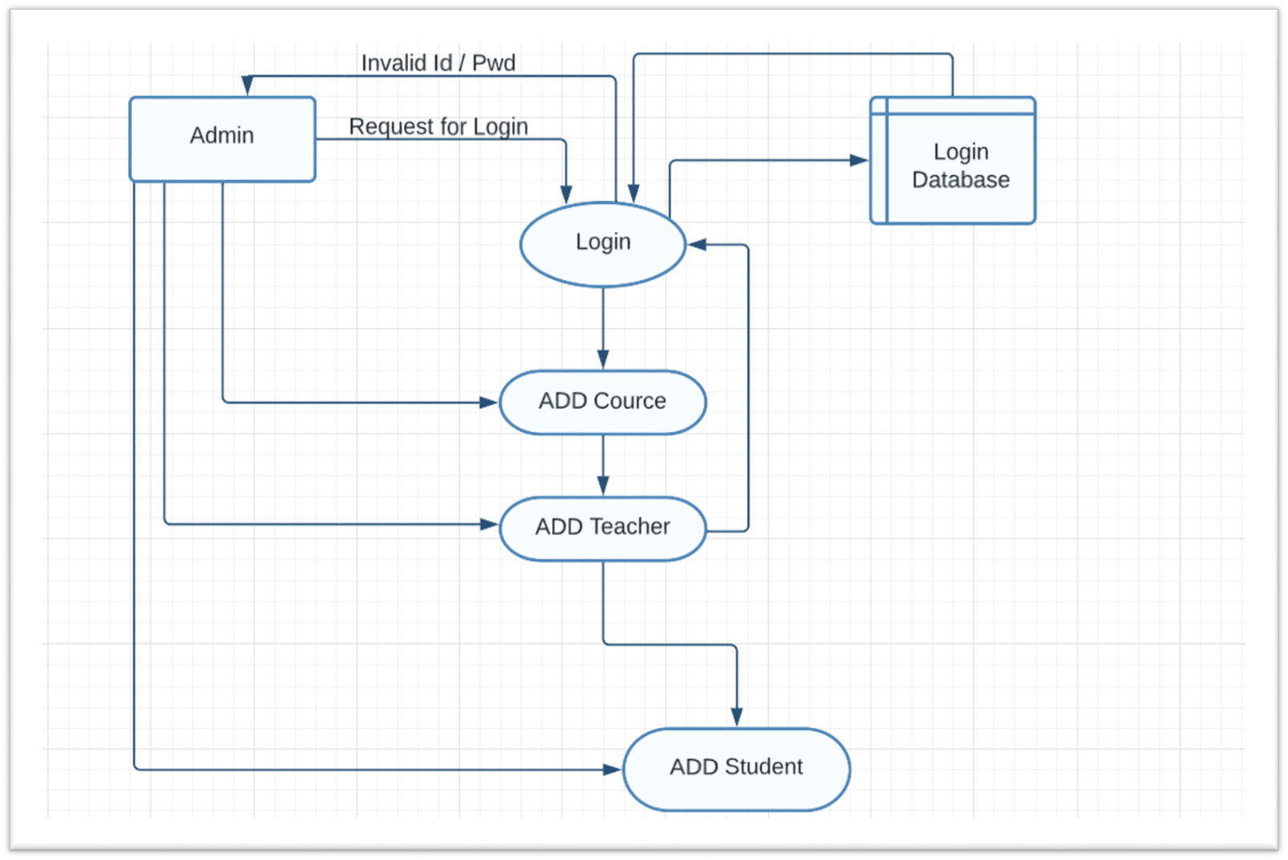
DFD level-1

Slide 8


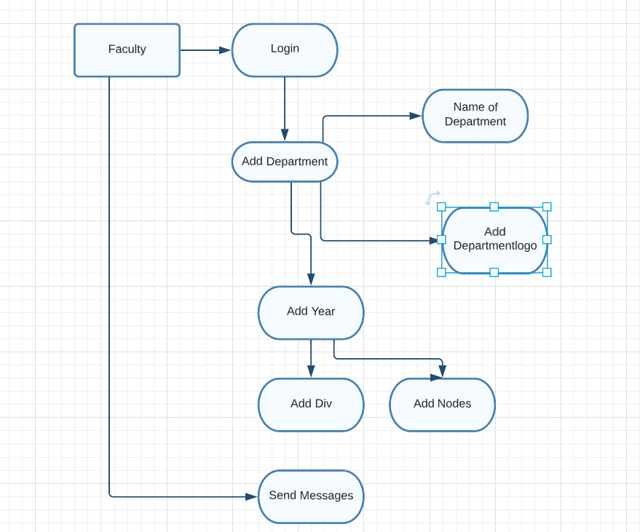
DFD Level-2

Slide 9


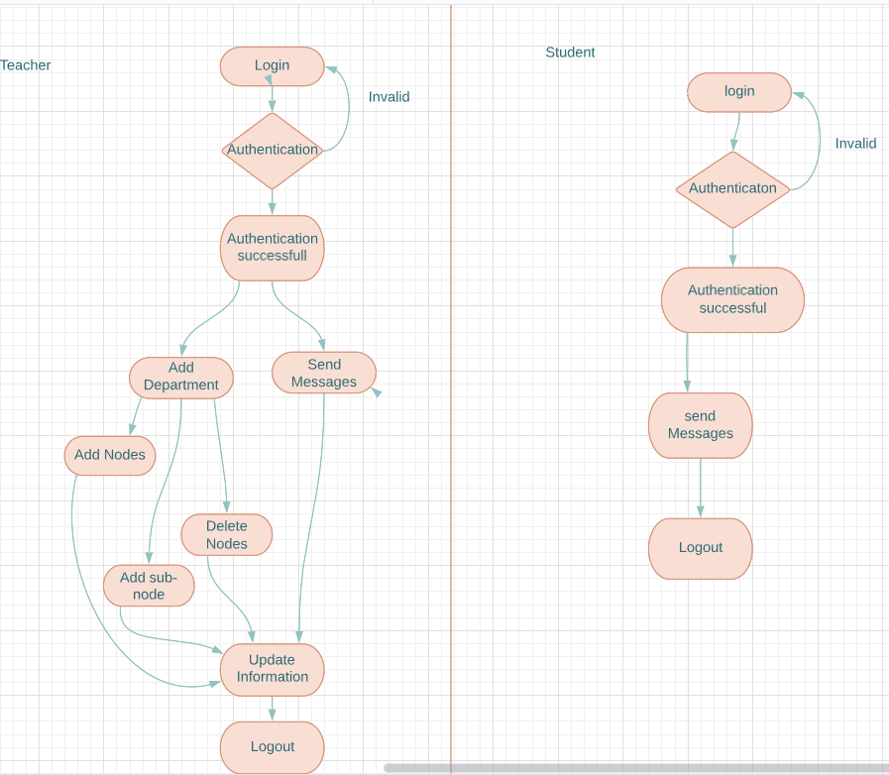
Activity Diagram

Slide 10


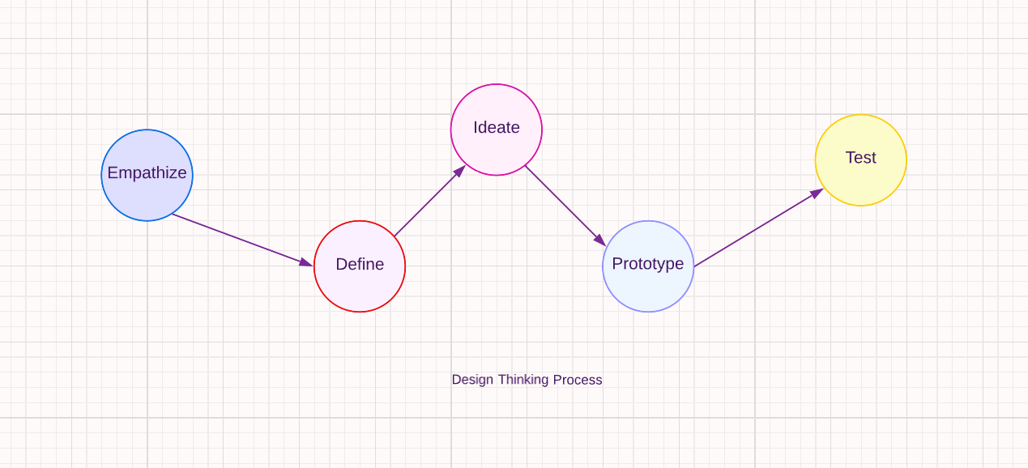
Methodology

Slide 11
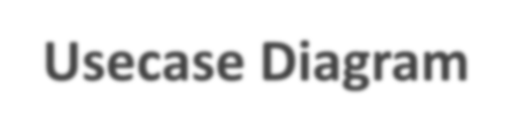

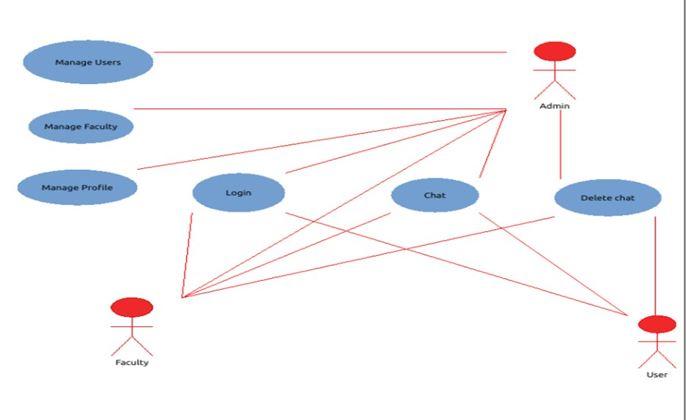
Usecase Diagram

Slide 12

Module’s
Student: The students have the ability to send and receive messages, files, and images in the channels to which they are allowed access. Each student has a unique profile
and they can customize it according to their needs.
Faculty: The faculty of the educational institute has access to all the features and rights which a student possess. They have rights to allot roles like Class representatives, etc. while providing the possessor of the role access to the veins which the other students aren’t. Unlike students, they have the ability to create veins

Slide 13

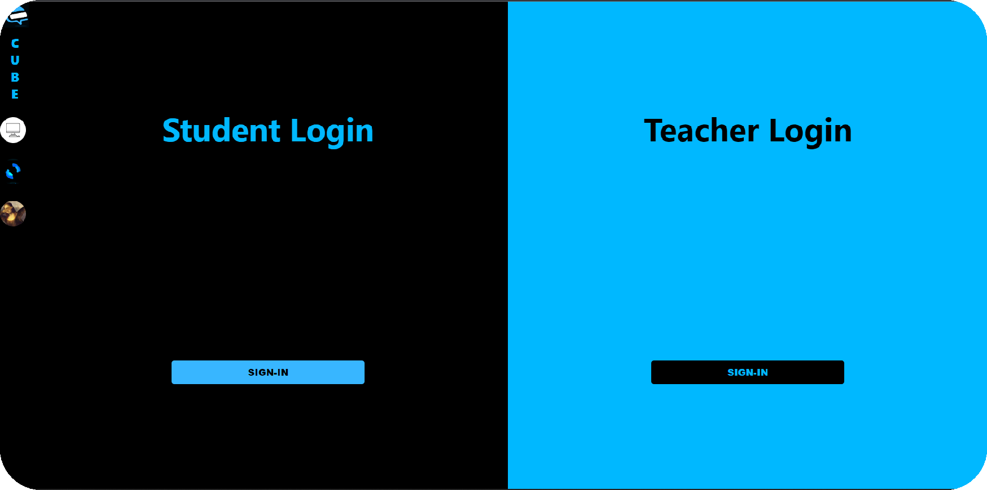

Login Page

Slide 14

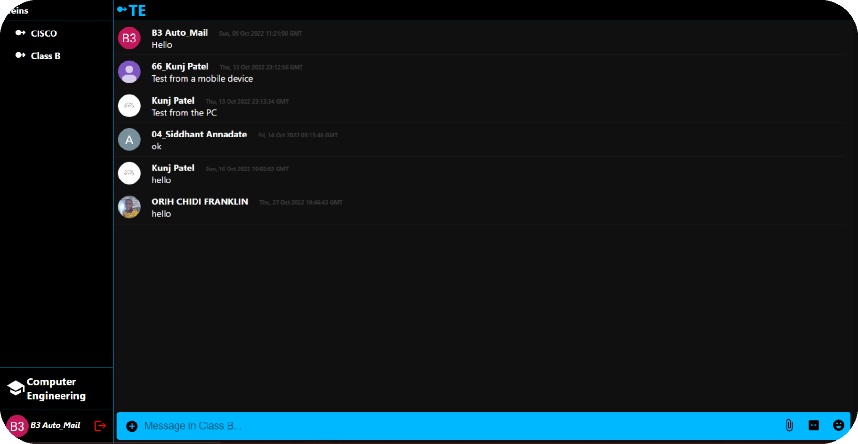
Student Page

Slide 15

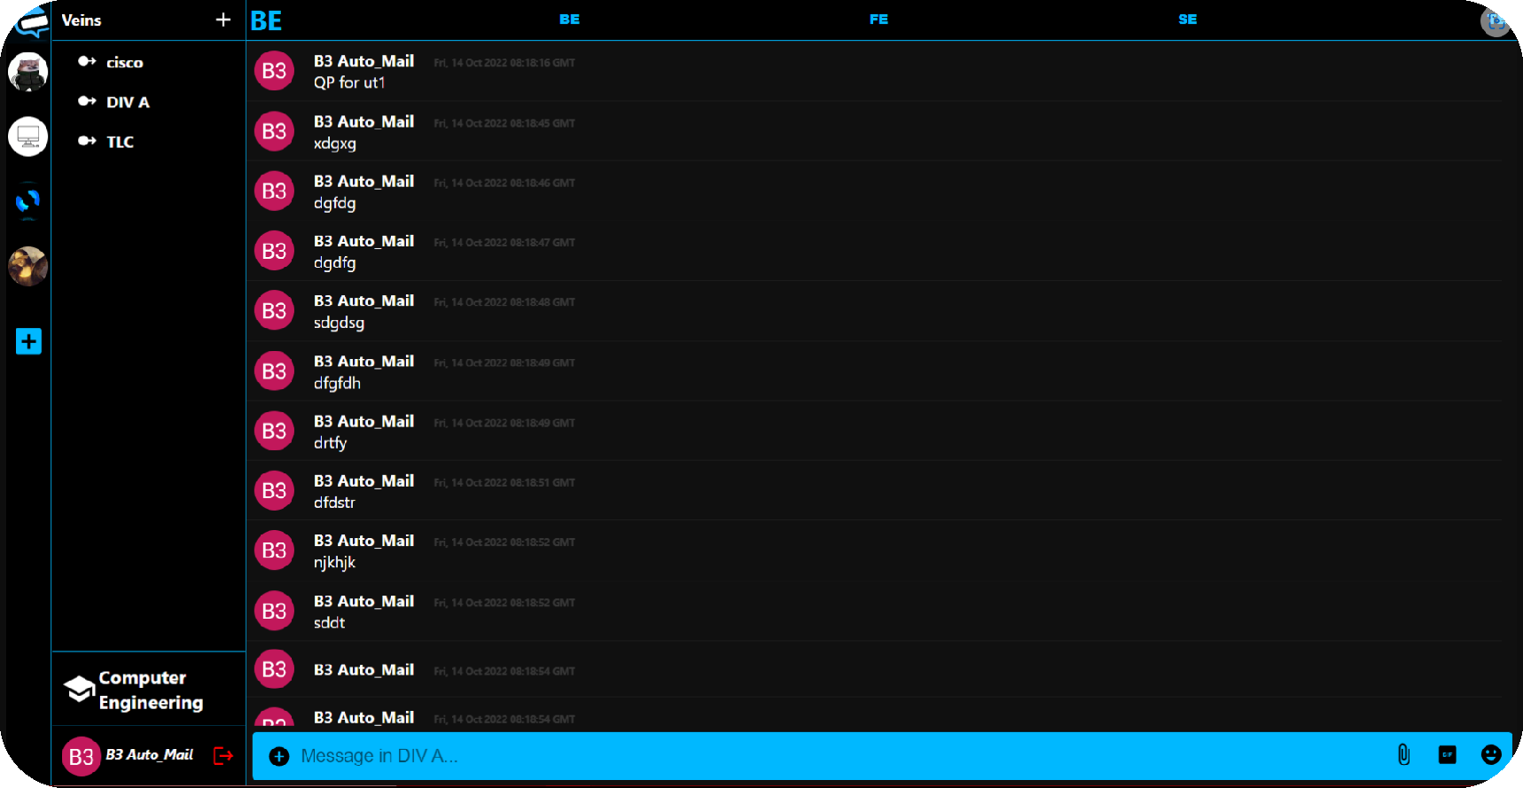
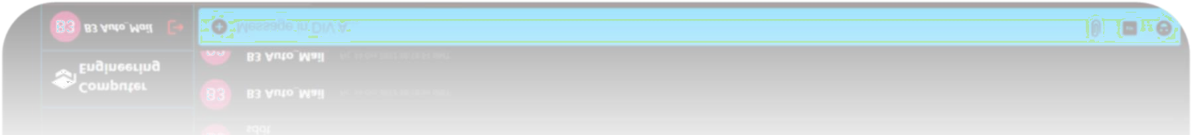
Educator Page

Slide 16


REFERENCE
https://www.researchgate.net/profile/Ban-N- Dhannoon/publication/322509087_Developing_an_End-to- End_Secure_Chat_Application/links/5a5d1134458515c03ede7ead/Developing-an- End-to-End-Secure-Chat-Application.pdf)
https://www.irjmets.com/uploadedfiles/paper//issue_3_march_2022/20421/fina l/fin_irjmets1648743194.pdf

Slide 17
THANKYOU!!!

